Slide 1

Analyzing Global Demographic Trends: A World Bank Perspective

Slide 2

Project Goal:
Explore the relationships between Birth Rate, Internet Usage, Fertility Rate, and Life Expectancy.

Slide 3
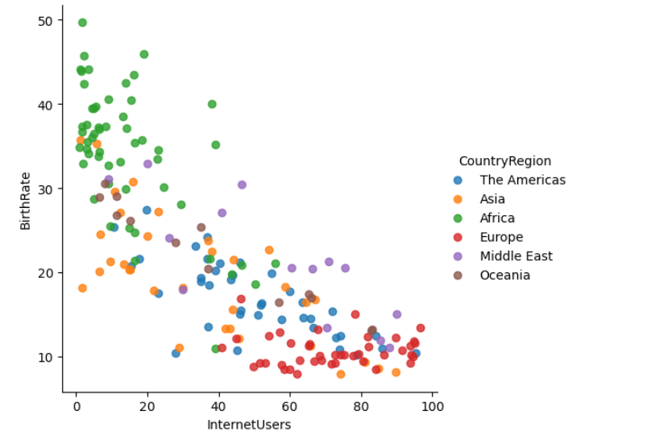
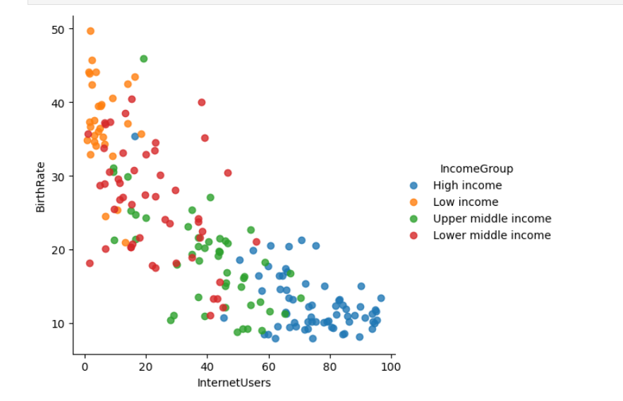
Birth Rate vs Internet Usage
Countries with higher income or from developed regions tend to have lower birth rates and higher internet access.
Low-income countries, especially in Sub-Saharan Africa and parts of South Asia, still experience high birth rates and low digital penetration.
Clear negative correlation between internet access and birth rate.

Slide 4
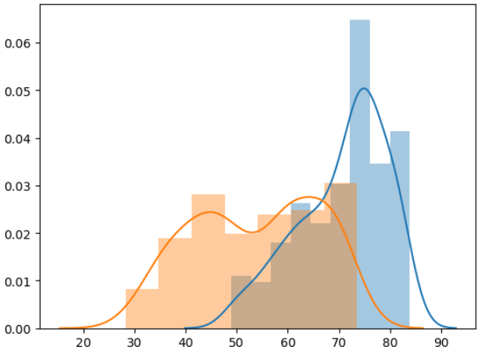
Life Expectancy (1960 vs 2013)
1960
In 1960 low life expectancy (<70 years).
2013
By 2013, most countries moved to higher life expectancy.

Slide 5
Key Insights & Recommendations
Insights:
Digital inclusion is a strong lever for reducing birth rates.
Global health and education improvements drive longer lives and smaller families.
Regional disparities are the biggest challenge to equitable development.
Recommendations:
Invest in digital infrastructure and education in low-income regions.
Integrate population policy with development planning.
Use data-driven strategies to target vulnerable areas more effectively.

Slide 6

Thank You

